Slide 1

STACK

Slide 2




OUR TEAM MEMBERS
MUNNA BISWAS
MONOWAR AFSAR
NAIMUL ISLAM SHUVO
221-15-5261
221-15-5366
221-15-4941
RIAD HOSSAIN
AHSANUL HOQUE ROMMAN
221-15-5249
221-15-5330

Slide 3
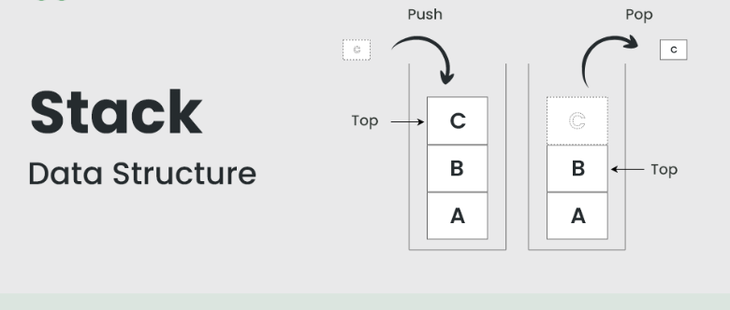
WHAT IS STACK?
Stack is a linear data structure that follows a particular order in which the operations are performed.

Slide 4
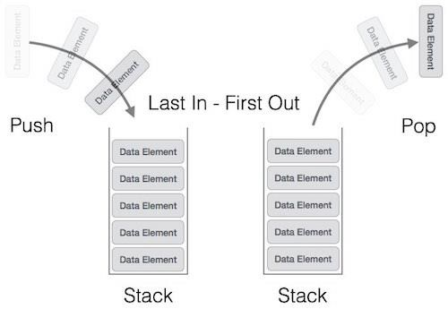
Behavior of Stack
LIFO: (Last in first out)
FILO: (First in last out)

Slide 5
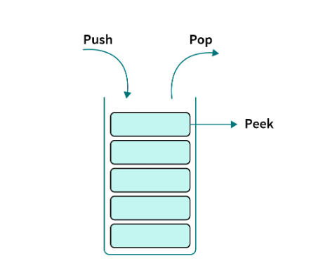
Stack Operations
PUSH (insertion)
POP (deletion)
Peek(calling top element)

Slide 6
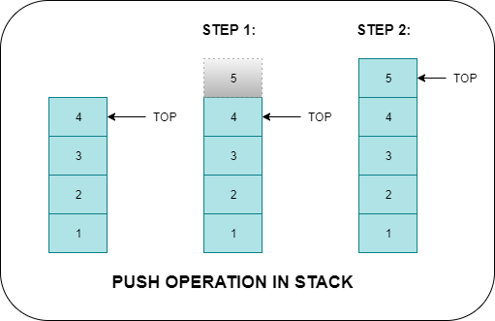
Push(x)
push() Push is a function in stack definition which is used to insert data at the stack's top.
push(5)

Slide 7
Algorithm of Push(x)
Insertion(a, top, item, max)
If top == max then
print "stack overflow"
Exit
else
top = top + 1
a[top] = item
Exit
push(5)

Slide 8
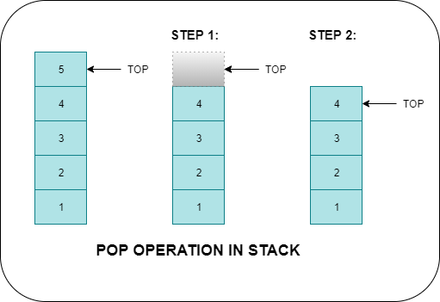
pop()
Pop is a function in the stack definition which is used to remove data from the stack's top.
pop()

Slide 9
Algorithm of pop()
Pop(a, top)
If top == -1 then
print "stack underflow“
Exit
else
item = a[top]
top = top - 1
return item
pop()

Slide 10
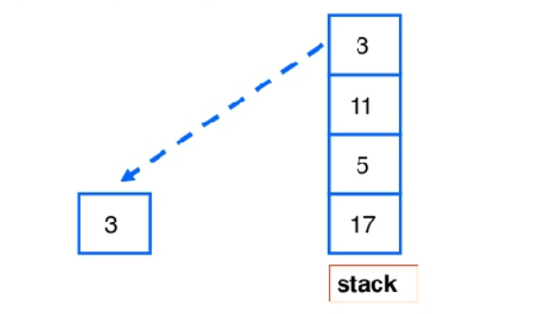
peek()
peek() function is used to retrieve or fetch the first element of the stack or the element present at the top of the stack.
peek()

Slide 11
A Stack can be used for evaluating expressions consisting of operands and operators.
Stacks can be used for check parenthesis matching in an expression.
It can also be used to convert one form of expression to another form.
It can be used for systematic Memory Management.
Used for reverse a string.
Used for undo mechanism.
Applications of Stack

Slide 12
Expression Evaluation
Prefix to infix
Infix to prefix
Postfix to infix
Infix to postfix
Prefix to postfix
Postfix to prefix

Slide 13
Prefix to infix
Read the Prefix expression in reverse order (from right to left)
If the symbol is an operand, then push it onto the Stack.
If the symbol is an operator, then pop two operands from the Stack and create it a string by placing the operator in between the operands an push it into the stack.
Repeat the above steps until the end of Prefix expression.

Slide 14
Prefix to infix
Symbol | Stack
K | K
V | KV
+ | (V+K)
U | (V+K)U
T | (V+K)UT
* | (V+K)(T*U)
/ | ((T*U)/(V+K))
S | ((T*U)/(V+K))S
R | ((T*U)/(V+K))SR
Q | ((T*U)/(V+K))SRQ
X | ((T*U)/(V+K))SRQX
^ | ((T*U)/(V+K))SR(X^Q)
* | ((T*U)/(V+K))S((X^Q)*R)
+ | ((T*U)/(V+K))(((X^Q)*R)+S)
- | (((X^Q)*R)+S)-((T*V)/(V+K)
Expression: -+*^XQRS/*TU+VK

Slide 15


THANK
YOU!
Have a great day ahead.

